Slide 1
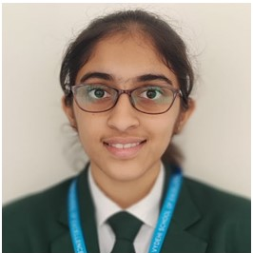
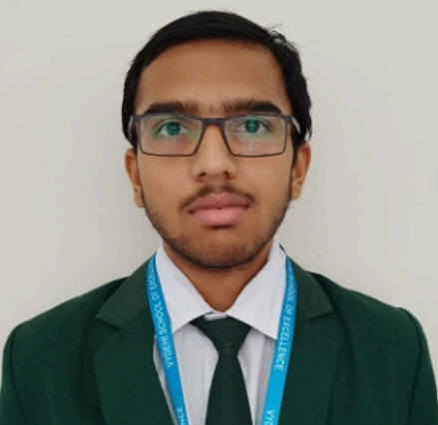
VYDEHI SCHOOL OF EXCELLENCE
GRADE 12 CBSE RESULT (2024-25)
SCIENCE TOPPER
COMMERCE TOPPER
KSHITI KESHAV PRABHU
Scored- 99.4%
AARUSH PRABHU TEKKETTE
Scored- 99.4%
CONGRATULATIONS TO TOPPERS

Slide 2
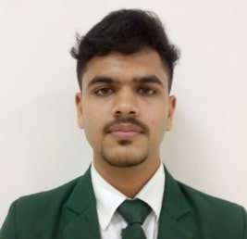
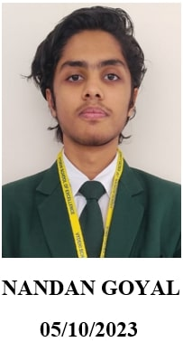
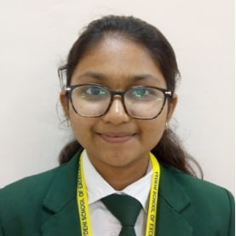
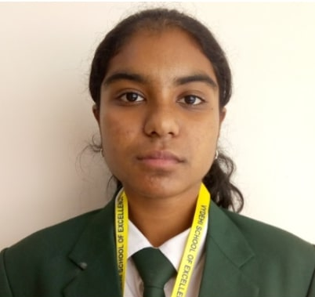
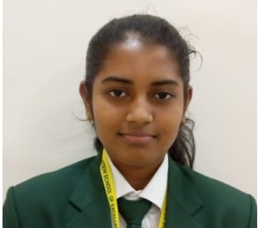
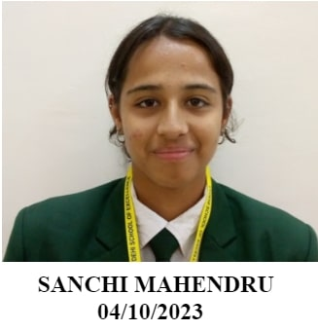
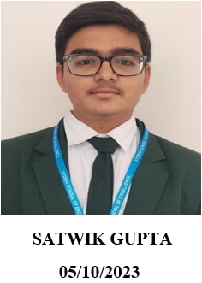
VYDEHI SCHOOL OF EXCELLENCE
GRADE 12 CBSE RESULT (2024-25)
HARSHIT JAIN
99.2%
NANDAN GOYAL
98.8%
B SRIKRITHI
97%
SAHANA SENTHIL KUMAR
96.8%
AMISHA TEJA ANAND
96.4%
SANCHI MAHENDRU
96.4%
SATWIK GUPTA
95.8%

Slide 3
VYDEHI SCHOOL OF EXCELLENCE
GRADE 12 CBSE RESULT (2024-25)
SUBJECT TOPPERS
PHYSICS
S. NO | NAME | MARKS
1 | KSHITI KESHAV PRABHU | 98
2 | NANDAN GOYAL | 96
MATHEMATICS
S. NO | NAME | MARKS
1 | KSHITI KESHAV PRABHU | 100
2 | NANDAN GOYAL | 100
CHEMISTRY
Sl. No | Name | Marks
1 | KSHITI KESHAV PRABHU | 100
2 | NANDAN GOYAL | 98
BIOLOGY
Sl. No | Name | Marks
1 | PAWANI JHA | 96
2 | SRUSHTHI SHESHAPPA JOGAPPANAVAR | 95

Slide 4
VYDEHI SCHOOL OF EXCELLENCE
GRADE 12 CBSE RESULT (2024-25)
SUBJECT TOPPERS
ENGLISH
SL. NO | NAME | MARKS
1 | NANDAN GOYAL | 100
2 | HARSHIT JAIN | 100
3 | SAHANA SENTHIL KUMAR | 100
4 | ANSHIKA PRASAD | 99
5 | HARSHA S S | 99
6 | ISHITA GULATI | 99
7 | JANANI SRIRAM | 99
8 | KSHITI KESHAV PRABHU | 99
9 | DIVIYA GUPTA | 99
10 | ISHANI JIGNESH CHUDASAMA | 99
11 | LALITHA HASINI CHALLAPALLI | 99
12 | SHIVANI JIGNESH CHUDASAMA | 99
13 | TAKSHI PANDEY | 99
14 | AARUSH PRABHU TEKKETTE | 99
PHYSICAL EDUCATION
S. NO | NAME | MARKS
1 | NIJUKTA MONDAL | 99
2 | AMISHA TEJA ANAND | 98
PAINTING
S. NO | NAME | MARKS
1 | HARIPRIYA S | 99

Slide 5
VYDEHI SCHOOL OF EXCELLENCE
GRADE 12 CBSE RESULT (2024-25)
SUBJECT TOPPERS
COMPUTER SCIENCE
S. NO | NAME | MARKS
1 | KSHITI KESHAV PRABHU | 100
2 | NANDAN GOYAL | 100
3 | SATWIK GUPTA | 99
MULTIMEDIA
S. NO | NAME | MARKS
1 | ANAVI BHARDWAJ | 98
2 | HAASINI POGARU | 98
INFORMATICS PRACTICES
S.NO | NAME | MARKS
1 | AARUSH PRABHU TEKKETTE | 100
2 | HARSHIT JAIN | 99
3 | B SRIKRITHI | 99
ARTIFICIAL INTELLIGENCE
S. NO | NAME | MARKS
1 | AYUSH KUMAR JHA | 100
2 | HARSHA S S | 100
3 | VARSHITHA V | 99

Slide 6
VYDEHI SCHOOL OF EXCELLENCE
GRADE 12 CBSE RESULT (2024-25)
SUBJECT TOPPERS
PSYCHOLOGY
S.NO | NAME | MARKS
1 | MRINALINI SRINIVASAN | 100
2 | LALITHA HASINI CHALLAPALLI | 100
3 | FARHINA MAHSIN I | 100
LEGAL STUDIES
S.NO | NAME | MARKS
1 | SAHANA SENTHIL KUMAR | 100
ENTREPRENEURSHIP
S.NO | NAME | MARKS
1 | NEIL RINKU MULCHANDANI | 99
APPLIED MATHS
S.NO | NAME | MARKS
1 | KRISHNA BARATH BHAARADWAJ | 96

Slide 7
VYDEHI SCHOOL OF EXCELLENCE
GRADE 12 CBSE RESULT (2024-25)
SUBJECT TOPPERS
ACCOUNTANCY
S.NO | NAME | MARKS
1 | AARUSH PRABHU TEKKETTE | 100
2 | HARSHIT JAIN | 99
ECONOMICS
S.NO | NAME | MARKS
1 | AARUSH PRABHU TEKKETTE | 99
2 | HARSHIT JAIN | 99
3 | SANCHI MAHENDRU | 99
4 | B SRIKRITHI | 98
5 | SAHANA SENTHIL KUMAR | 98
6 | AMISHA TEJA ANAND | 98
BUSINESS STUDIES
S.NO | NAME | MARKS
1 | AARUSH PRABHU TEKKETTE | 99
2 | HARSHIT JAIN | 99
3 | B SRIKRITHI | 98

