Slide 1



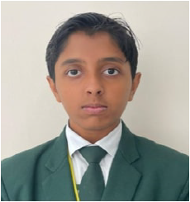
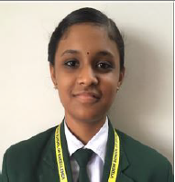

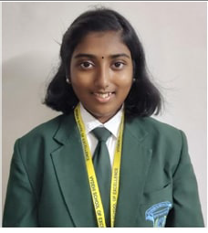

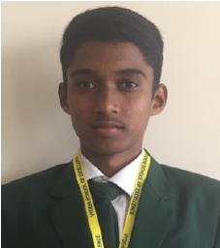
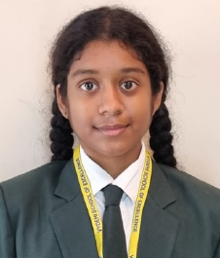
VYDEHI SCHOOL OF EXCELLENCE
GRADE 10 CBSE RESULT (2024-25)
SCHOOL TOPPERS
SANATAN GOYAL
Scored- 97.8 %
SHREYA VINOD
Scored- 97.8 %
KEERTHANA JAGANNATHAN
Scored- 99 %
CHEEDELLA SAI HANEESH
Scored- 97.2 %
JEYASHREE KEERTHANA
CHIDAMBARAM
Scored- 97.2 %

Slide 2
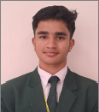
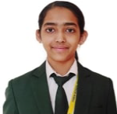
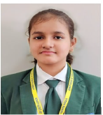
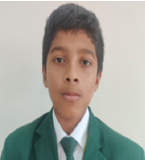
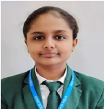
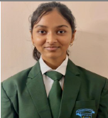
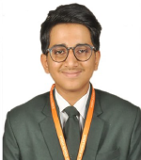
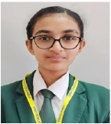
VYDEHI SCHOOL OF EXCELLENCE
GRADE 10 CBSE RESULT (2024-25)
TOPPERS
GOLLAPALLI SAKETH RAM
Scored- 97 %
SHISHIRA BHAT
Scored- 96.8 %
NIDHI AGRAWAL
Scored- 96.8 %
AKILAN SIVAKUMAR V
Scored- 96.8 %
SOWMIYA
Scored- 96.8 %
KANIKA GUPTA
Scored- 96.8 %
ANIRUDH MUKUNDHAN
Scored- 96.8 %
AVYUKTA DINESH
Scored- 96.8 %

Slide 3
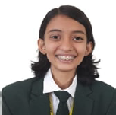
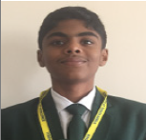
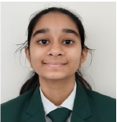
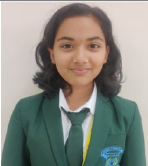
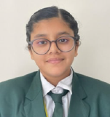
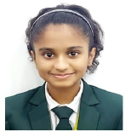
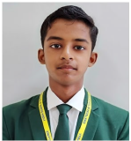
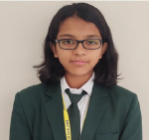
VYDEHI SCHOOL OF EXCELLENCE
GRADE 10 CBSE RESULT (2024-25)
TOPPERS
SUHANI SINHA
Scored- 96.4 %
RADHESH RAJGANESH
Scored- 96.4 %
AVISHI GUPTA
Scored- 96.2 %
NETRA NITIN
CHANDANKHEDE
Scored- 96.2 %
AARZU SARA STEPHEN
Scored- 96 %
PRACHITEE JOG
Scored- 96 %
ISHIKA PATANAIK
Scored- 96 %
SAMARTH MOHANTY
Scored- 96 %

Slide 4
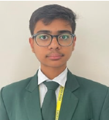
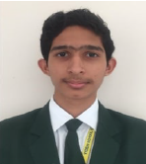
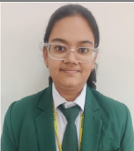
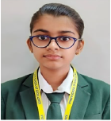
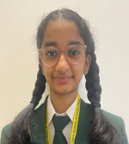
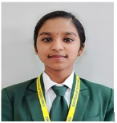
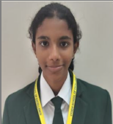
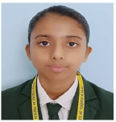
VYDEHI SCHOOL OF EXCELLENCE
GRADE 10 CBSE RESULT (2024-25)
TOPPERS
PARTH BANSAL
Scored- 95.8 %
AASHREY KUMAR
Scored- 95.8 %
KASHIKA GAUR
Scored- 95.8 %
KAJAL SUDHIR CHAUDHARI
Scored- 95.6 %
BHAVNA VASANTHAN
Scored- 95.6 %
PARVATHY V M
Scored- 95.6 %
ADHITRI JYOTSNA
BHEEMINENI
Scored- 95.4 %
RIDDHI SINGH
Scored- 95.2 %

Slide 5
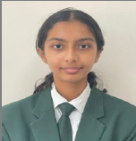
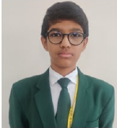
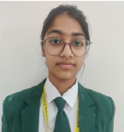
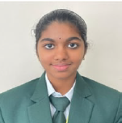
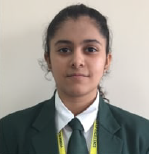
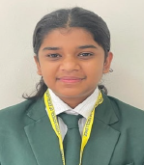
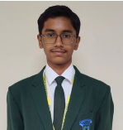
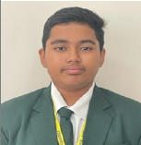
VYDEHI SCHOOL OF EXCELLENCE
GRADE 10 CBSE RESULT (2024-25)
TOPPERS
ANVITHA P
Scored- 95.2 %
SHUSHRUTH BETHUR
Scored- 95.2 %
CHARVI REDDY GUNUKULA
Scored- 95.2 %
ARCHANA A S
Scored- 95 %
AKSHARA KUMAR
Scored- 95 %
AYATI SULTANIA
Scored- 95 %
SAYAN BOSE
Scored- 95 %
SRINANDAN PASUNURTHI
Scored- 95 %

Slide 6
VYDEHI SCHOOL OF EXCELLENCE
GRADE 10 CBSE RESULT (2024-25)
SUBJECT TOPPERS
ENGLISH
S.NO | TOPPER’S NAME | MARKS
1 | AKILAN SIVAKUMAR V | 99
2 | HARSH NAKARANI | 99
3 | KEERTHANA JAGANNATHAN | 98
4 | SHREYA VINOD | 98
5 | CHEEDELLA SAI HANEESH | 98
6 | JEYASHREE KEERTHANA CHIDAMBARAM | 98
7 | ANIRUDH MUKUNDHAN | 98
8 | PRACHITEE JOG | 98
9 | ISHIKA PATANAIK | 98
10 | ARCHANA A S | 98
11 | ARNAV AMERIA | 98
12 | AARAV SAXENA | 98
13 | RUTH JACOB | 98
HINDI
S.NO | TOPPER’S NAME | MARKS
1 | SOWMIYA | 98
2 | SANATAN GOYAL | 98
3 | NIDHI AGRAWAL | 97
4 | DEVANSH TYAGI | 97
5 | CHEEDELLA SAI HANEESH | 97
MATH
S.NO | TOPPER’S NAME | MARKS
1 | PARTH BANSAL | 100
2 | SHISHIRA BHAT | 100
3 | SANATAN GOYAL | 99
4 | AVYUKTA DINESH | 99
5 | AVISHI GUPTA | 99
6 | KAJAL SUDHIR CHAUDHARI | 99

Slide 7
